Slide 1
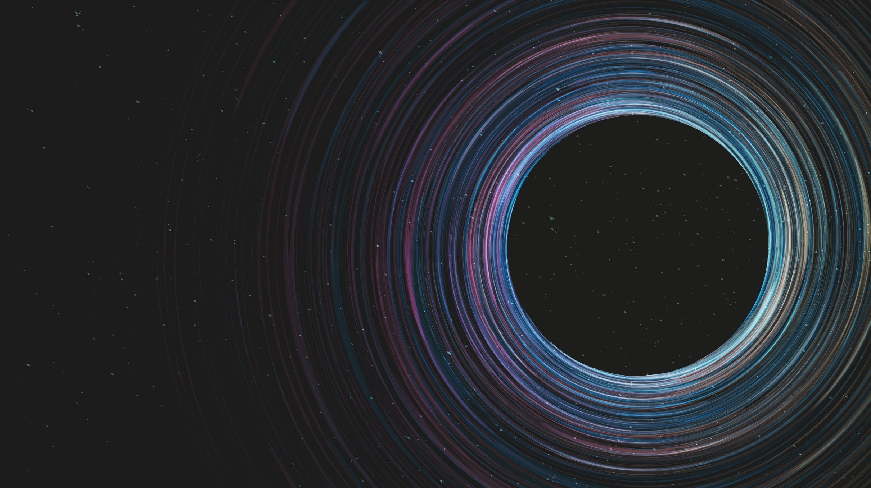
Parameter Estimation of Global 21cm Signal

Slide 2
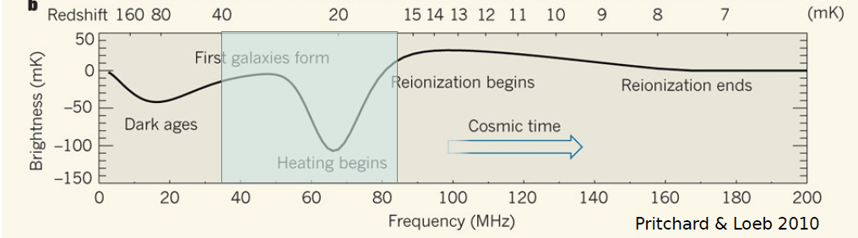

The Global 21cm Signal (of Neutral Hydrogen)
End of the cosmic dark ages → formation of first stars and galaxies
Sensitive to the density and temperature of neutral hydrogen in the early universe
Any deviation from the predictions of the standard cosmological model → presence of new physics
Notes:
The global 21cm signal has been used to study the period between the end of the cosmic dark ages and the formation of the first stars and galaxies.
It is widely known that the 21cm signal is sensitive to the density and temperature of neutral hydrogen in the early universe and the presence of the first stars and galaxies. Therefore, any deviation from the predictions of the standard cosmological model of this signal could indicate the presence of new physics beyond the standard model.
In my master’s thesis, I explored the potential of this signal to reveal non-standard physics by means of providing a new path to test our fundamental physical theories.
As an example to illustrate these non-standard effects, In a study by Robert Brandenberger and Oscar Hernandez, It was analytically proven that
Adding the effects of cosmic string wakes may change the amplitude of the global 21cm signal up to 200%.

Slide 3
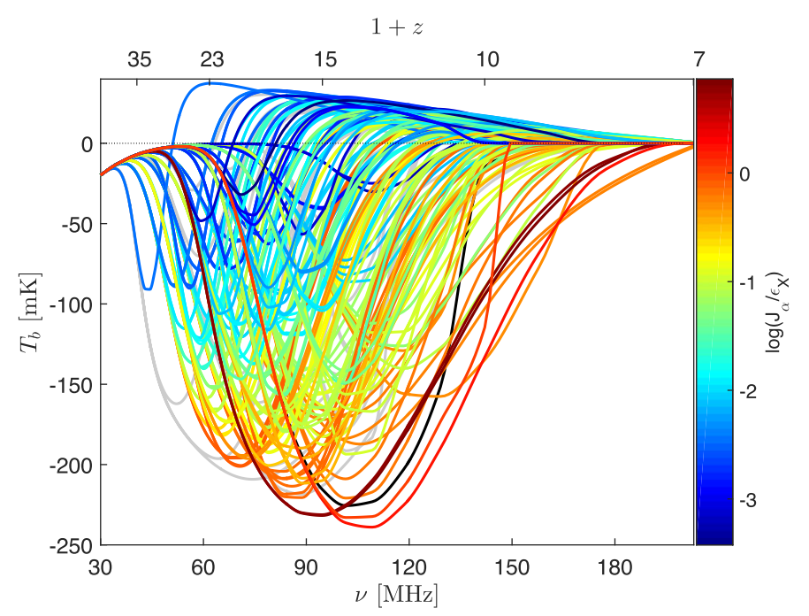
Markov Chain Monte Carlo (MCMC) + Levenberg Marquardt (LM)
Estimate the best-fit physical parameters
Accelerated Reionization Era Simulations (ARES)
Set theoretical limits for the precision of upcoming experiments
Experiment to Detect the Global EoR Signature (EDGES)
Cohen et al, 2016
Notes:
In order to achieve that goal and to better understand the physics behind this signal, I adopt the Markov Chain Monte Carlo (MCMC) method combined with the Levenberg Marquardt (LM) algorithm to estimate the best-fit physical parameters of the theoretical 21cm curves (e.g., star formation efficiency, recombination rate). We use the Accelerated Reionization Era Simulations (ARES) to generate our theoretical models for the global 21-cm signal. The developed method is flexible to the choice of parameters from ARES.
(This is a plot showing the 21-cm global signal as a function of redshift, for 193 different astrophysical models)
The eventual goal is that the knowledge of these best-fit parameters will help us to constrain future proposed models and set theoretical limits for the precision of upcoming experiments to observe the desired non-standard effects.
For this purpose, I focus on the second absorption through which is believed to exist due to the effects of Lya background. For this specific region of signal, there is an available observational dataset from the Experiment to Detect the Global EoR Signature (EDGES),

Slide 4
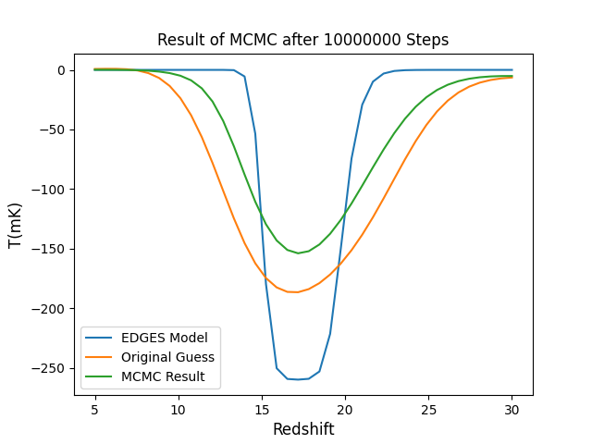
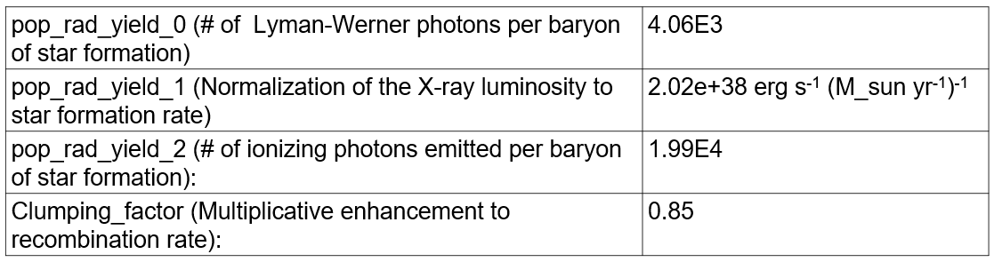
MCMC with RBFI (Radial Basis Function Interpolation)
Notes:
To talk a bit more about the specific methods that I used, I developed a Python script that uses MCMC to fit the parameters of the global 21cm signal. At each step of the algorithm, the model generated by ARES is compared to observational data by calculating the chi-square. I used data released by the EDGES group as the basis for our fitting process, but the script is open to any future datasets (for this specific run shown here, we used EDGES model with half of the original amplitude).
As ARES can have rather long runtimes, we developed an emulator based on ARES curves using radial basis function interpolation. This emulator can generate global 21cm curves approximately a thousand times faster than ARES.
With the emulator's help, we were able to run the MCMC for up to ten million steps and confirm the convergence of the chain.

Slide 5
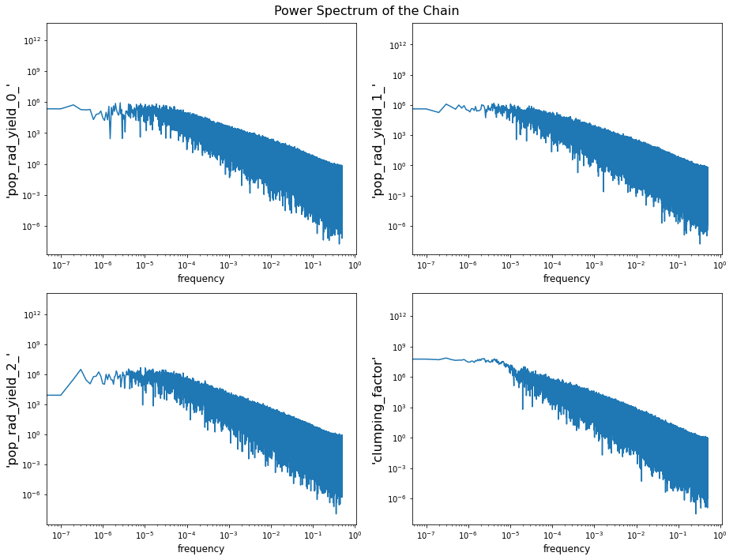
Convergence
Notes:
The convergence of this chain was confirmed by analyzing its power spectrum, which exhibited a flat behavior on low frequencies.

Slide 6
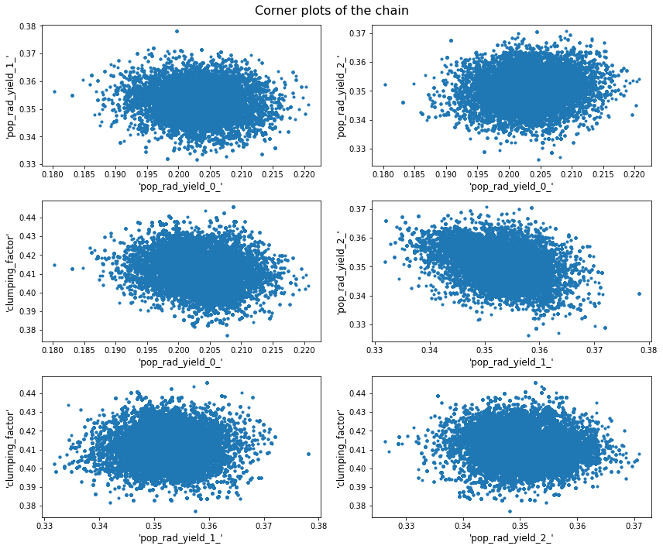
Corner Plots
Notes:
Since we know that MCMC chains should usually converge in a thousand to ten thousand steps, we are trying to improve the algorithm’s efficiency.
In order to achieve faster convergence of MCMC chains, we are exploring various methods, one of which involves using a posterior distribution for the MCMC that accounts for correlations between different parameters.
As you can see in theses plots, at least two of the four chosen parameters indicate patterns of correlation.

Slide 7
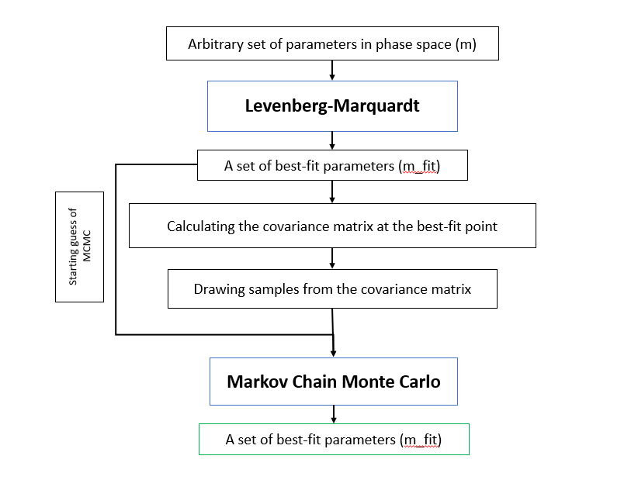
Notes:
To generate this posterior distribution, we first use a Levenberg-Marquardt fitter to obtain a set of best-fit parameters and the covariance matrix of parameters based on the local derivatives of the likelihood at the best-fit point. We then draw samples from this covariance matrix to generate the posterior distribution.
And we feed these new samples to our MCMC.
Currently, we are using this method to improve the convergence of our MCMC chains.

Slide 8
References
[1] Judd D Bowman et al. Nature 555.7694 (2018), pp. 67–70.
[2] Aviad Cohen et al. Monthly Notices of the Royal Astronomical Society 472.2 (2017), pp. 1915–1931.
[3] Jordan Mirocha. Monthly Notices of the Royal Astronomical Society 443.2 (2014), pp. 1211–1223.

Slide 9
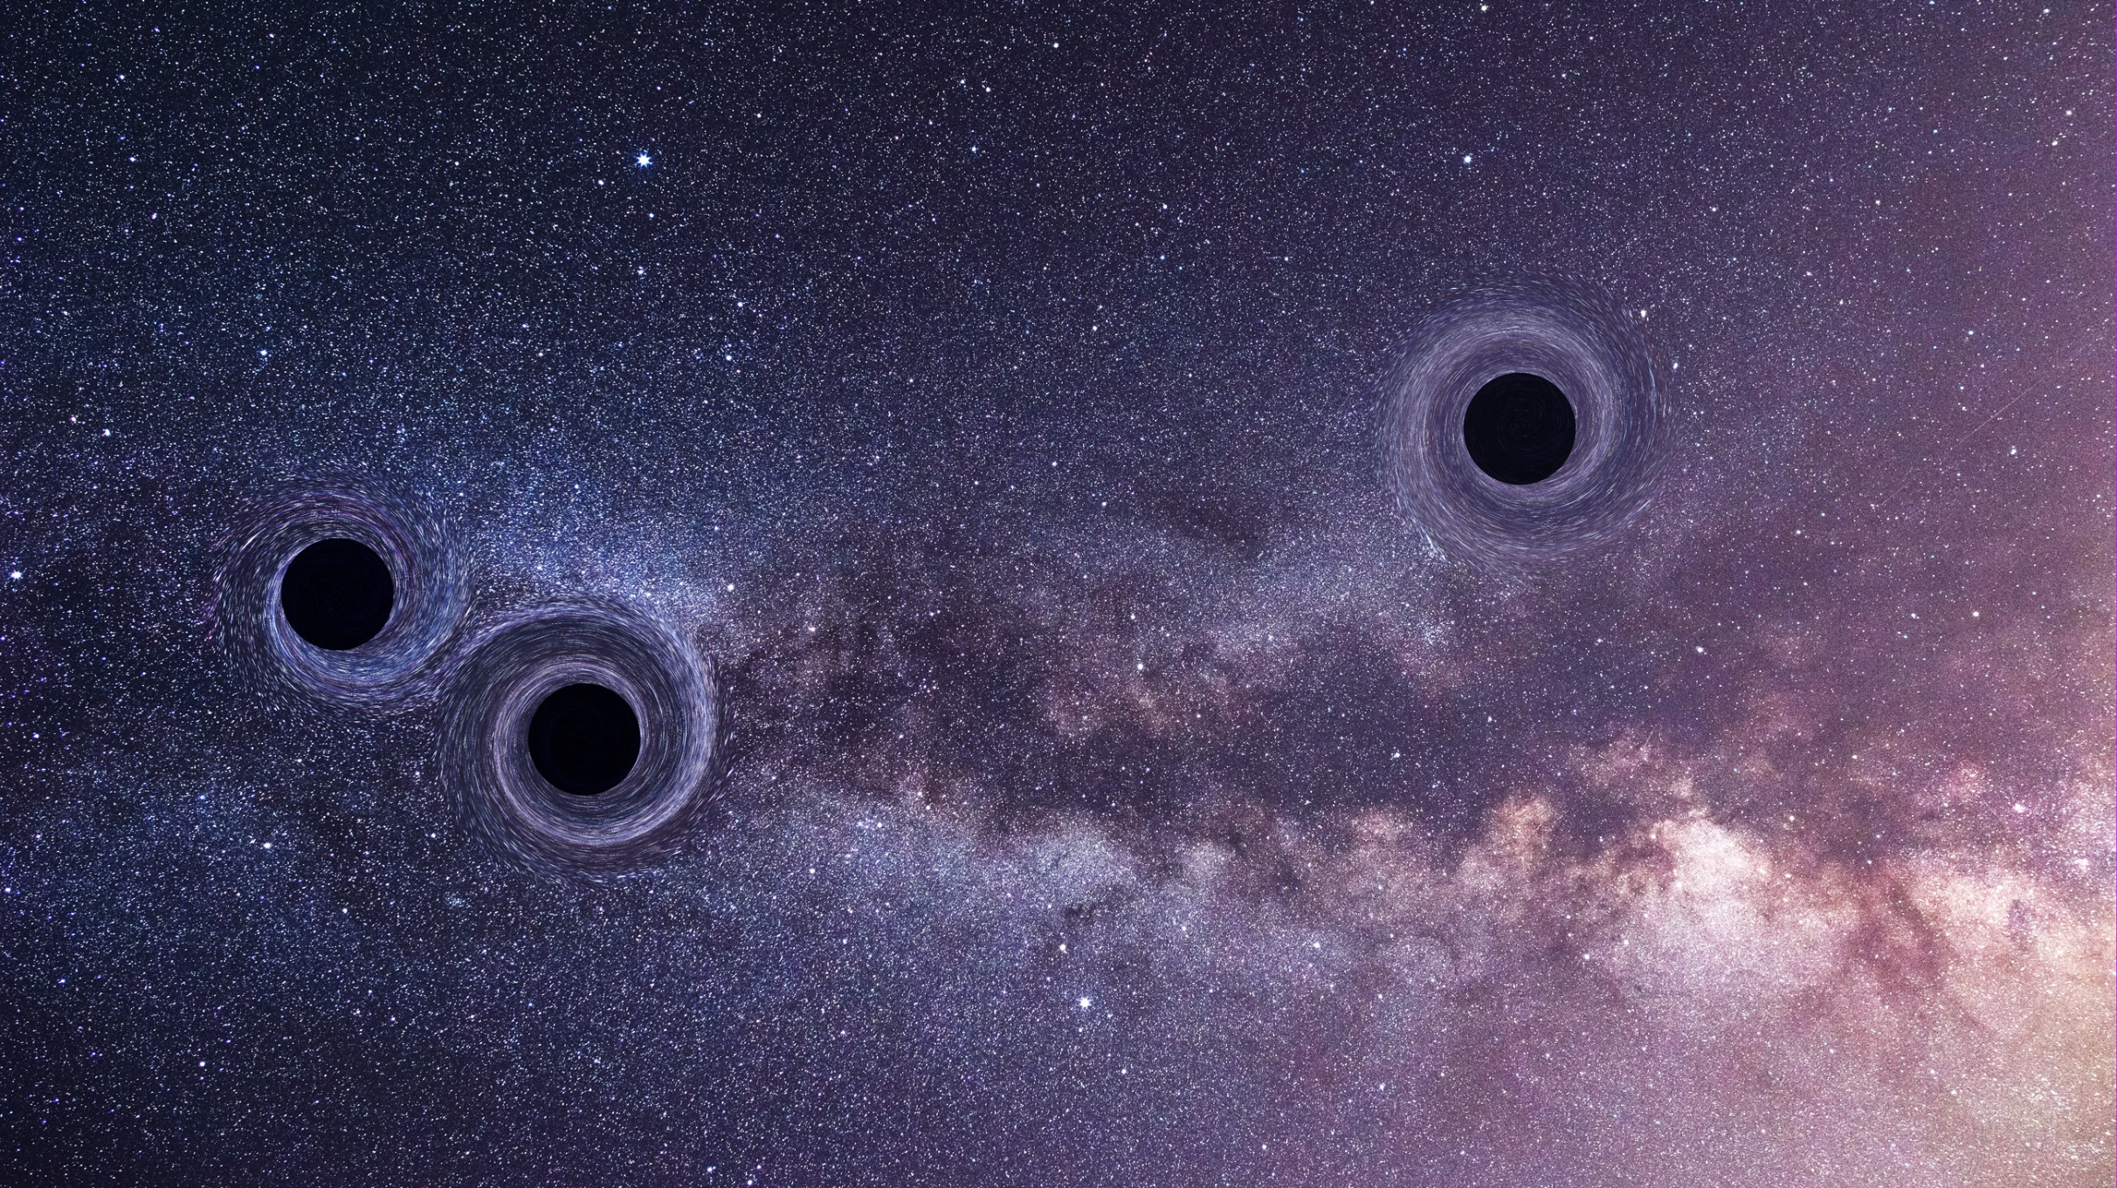
Thank You for Your Attention

